Slide 1


Project Report on
AI in HEALTHCARE (Diagnosis and Treatment Application)
(HEART-RISK CALCULATOR)
NAME - MOHAMMED FAIZAN & SUJOY DAS
SECTION - K21QT
REGISTRATION NO - 12115149,12116211
SUBJECT - INT 404 (AI)
PROJECT REPORT TOPIC - HEART RISK CALCULATOR
SUBJECT TEACHER - AKSHARA RANA MAM
COLLEGE - LOVELY PROFESSIONAL UNIVERSITY

Slide 2

Introduction to Artificial Intelligence
•Artificial Intelligence (AI) is an interdisciplinary field
of computer science that deals with the creation of intelligent machines that can perform tasks that
usually require human intelligence, such as learning, problem solving, perception, and natural language processing.
•It focuses on training AI machines to analyze data and identify patterns to create models that can make predictions or decisions. Machine learning, deep learning, and neural networks are some of the most widely used techniques in AI.
•AI applications are used in various fields, such as healthcare, finance, transportation, and education, and have the potential to transform society and bring about significant changes in the future.

Slide 3
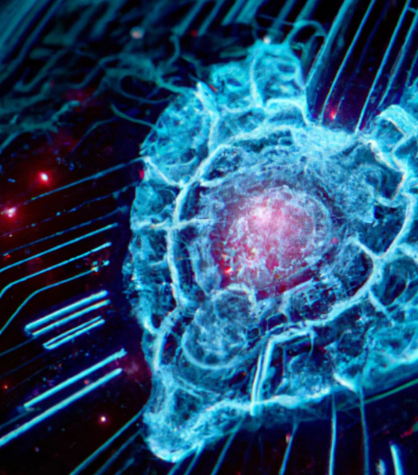
INTRODUCTION
Artificial Intelligence (AI) has been making significant strides in healthcare, particularly in the area of heart disease. One of the most promising applications of AI in this field is the development of heart-risk calculators.
These calculators use machine learning algorithms to predict a patient's risk of developing heart disease based on various factors such as age, gender, blood pressure, cholesterol levels, and family history.

Slide 4
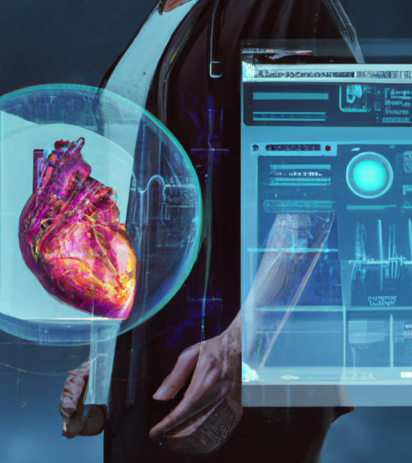
The Need for Accurate Risk Assessment
Accurate risk assessment is crucial in preventing heart disease, which is the leading cause of death worldwide. Traditional methods of risk assessment rely on statistical models that may not take into account all relevant factors or may be too general to provide personalized predictions.
AI-powered heart-risk calculators, on the other hand, can analyze vast amounts of data and identify patterns that may not be apparent to humans. This can result in more accurate risk assessments and personalized prevention strategies.

Slide 5
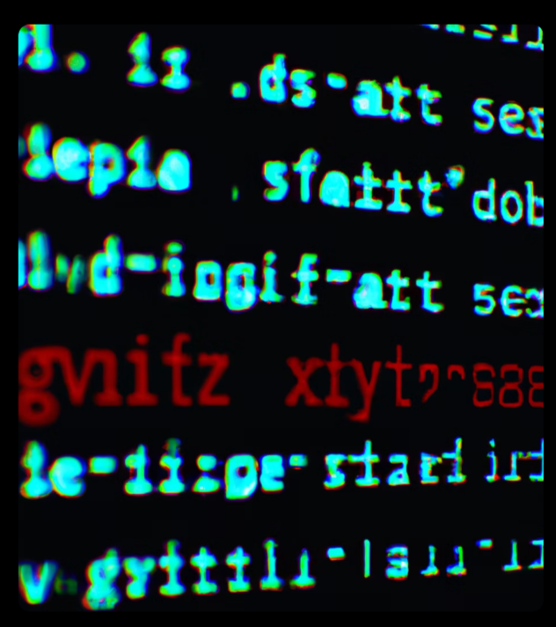
Challenges in Developing Heart-Risk Calculators
Developing accurate heart-risk calculators using AI poses several challenges. One of the main challenges is obtaining high-quality data that is representative of diverse populations.
Another challenge is ensuring that the algorithms used in the calculators are transparent and explainable so that clinicians and patients can understand how the risk scores are generated and make informed decisions based on them.

Slide 6

Benefits of AI-Powered Heart-Risk Calculators
Despite the challenges, AI-powered heart-risk calculators offer several benefits. They can provide more accurate risk assessments than traditional methods, which can lead to earlier interventions and better outcomes for patients.
In addition, these calculators can help clinicians identify high-risk patients who may benefit from more intensive prevention strategies, such as lifestyle changes or medication.

Slide 7
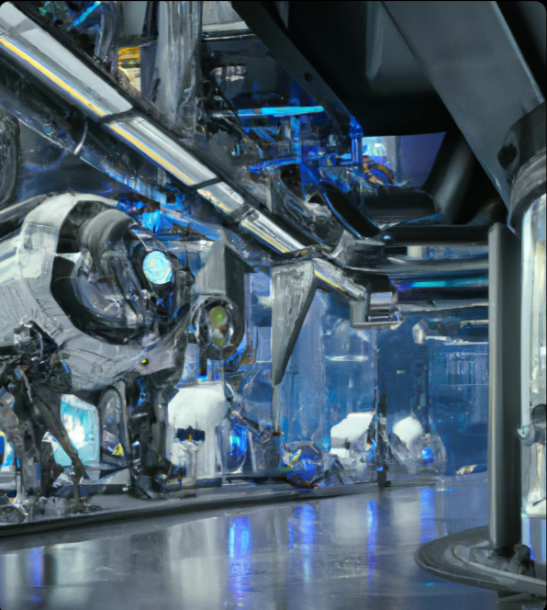
The Future of AI in Healthcare
AI-powered heart-risk calculators are just one example of how AI is transforming healthcare. In the future, we can expect to see even more sophisticated applications of AI in areas such as diagnosis, treatment planning, and drug discovery.
While there are concerns about the ethical implications of using AI in healthcare, such as data privacy and bias, the potential benefits are too great to ignore. As AI continues to evolve, it has the potential to revolutionize the way we approach healthcare and improve outcomes for patients worldwide.

Slide 8

Conclusion
AI-powered heart-risk calculators have the potential to transform the way we approach heart disease prevention and management. By providing more accurate risk assessments and personalized prevention strategies, these calculators can improve outcomes for patients and reduce healthcare costs.
As AI technology continues to evolve, we can expect to see even more innovative applications of AI in healthcare. While there are challenges and ethical concerns to address, the potential benefits are too great to ignore.

Slide 9
THANK YOU

